Slide 1


Review the Dockerfile
Introduction

Slide 2
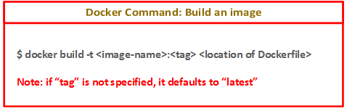
Build an image from the Dockerfile
Introduction

Slide 3
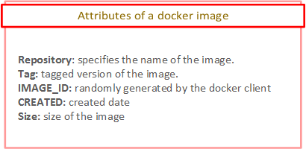
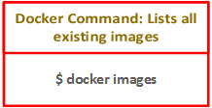
Listing all images
Introduction

Slide 4
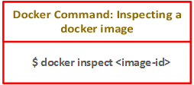
Inspect Images
Introduction

Slide 5
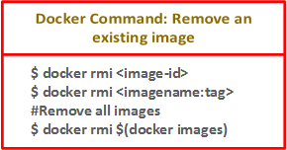
Removing Existing Docker Images
Note: Removing docker images is possible only if the containers they are associated with are removed.
Introduction

Slide 6
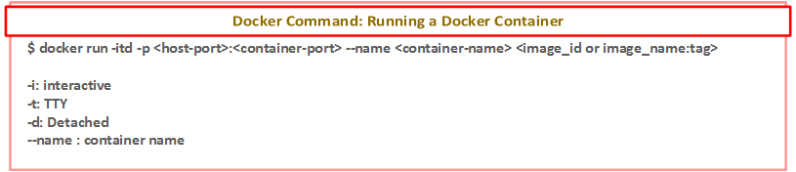
Create a container from the image
Introduction

Slide 7
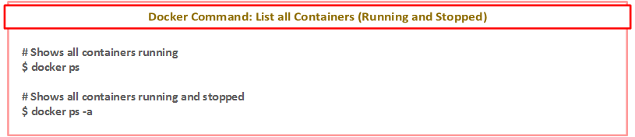
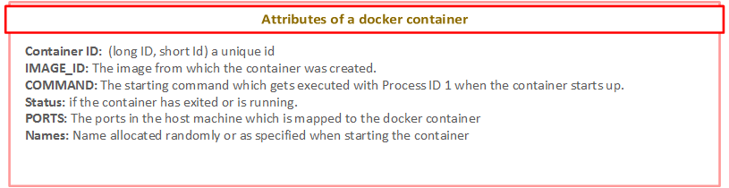
List Docker Containers
Introduction

Slide 8
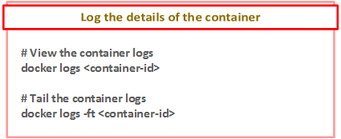
Review logs of the container
Introduction

Slide 9
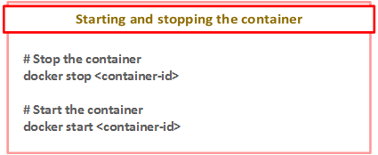
Stop and Start Containers
Introduction

Slide 10
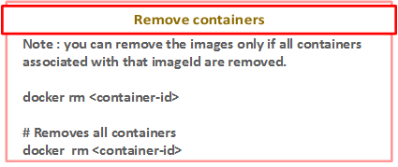
Removing Containers
Introduction

